Slide 1


The Silent Epidemic:
Abuse, Neglect, and Exploitation of Individuals with Developmental Disabilities
Family Café Presentation
June 2018
Rick Scott Governor
Barbara Palmer
APD Director

Slide 2

Florida Statute 415- Adult Protective Services Act
Florida Statute 39- Proceedings Relating to Children
Notes:
There are many laws in Florida which define and describe abuse, neglect and exploitation committed against children and adults with developmental disabilities by their caregivers or those in charge of ensuring the health and safety of the individual. The two main legislative statutes are 415 which governs the abuse, neglect and exploitation of adults and 39 which governs the abuse, neglect and exploitation of children.

Slide 3


415.101: Adult Protective Services Act
The Legislature recognizes that there are many persons in this state who, because of age or disability, are in need of protective services. Such services should allow such an individual the same rights as other citizens and, at the same time, protect the individual from abuse, neglect and exploitation.

Slide 4
39.001 Proceedings Relating to Children
To provide the care, safety, and protection of children in an environment that fosters healthy social, emotional, intellectual, and physical development; ensure secure and safe custody; to promote the health and well-being of all children under the state’s care; and to prevent the occurrence of child abuse, neglect, and abandonment.

Slide 5

October 1, 2004
The Agency for Persons with Disabilities joined forces with the Department of Children and Families, in order to achieve equitable delivery of services to persons with developmental disabilities, who are victims of abuse, neglect, exploitation or in need of services.
Notes:
The Agency for Persons with Disabilities joined forces with the Department of Children and Families in order to achieve equitable delivery of services to persons with developmental disabilities who are victims of abuse, neglect, exploitation or in need of services.

Slide 6

Examples of Abuse, Neglect and Exploitation
Verbal abuse such as taunting, name calling or threatening,
Mental Injury or emotional stress,
Sexual Abuse such as inappropriate, unwanted touching of sexual parts,
Physical abuse such as hitting, pushing, choking, punching, over medicating,
Cyber Bullying/Abuse- harassment, threats, unwanted social media posts that lead to mental injury, or unwanted sexting,
Mistreating service animals,
Withholding food and medications,
Leaving individuals unattended with no way to call for help,
Leaving individuals in bed all day or in soiled diapers,
Taking individual money or car to use for your personal use and not for use of the individual.

Slide 7
Common Case
Characteristics of People Living with Disabilities

Slide 8
People with Developmental Disabilities are more likely to experience:
Different types of abuse, neglect, and exploitation; which is more severe and lasts for longer periods of time,
Multiple and Repeat Perpetrators,
Abused more frequently than others,
Difficulty escaping abusive situations, finding justice or services,

Slide 9

What does the data say?

Slide 10
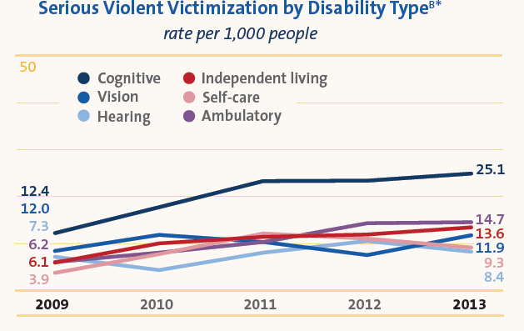
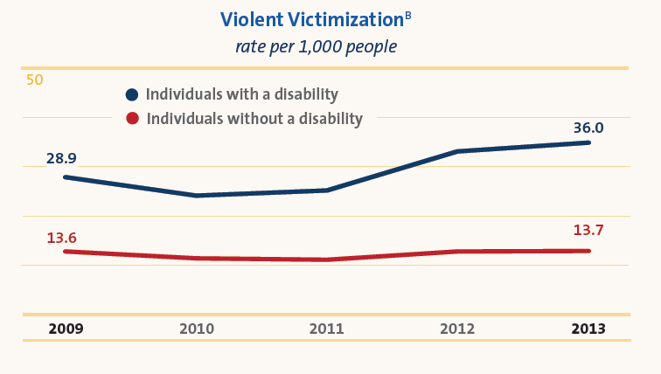
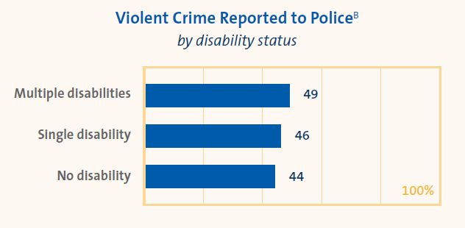
Rate of Victimization

Slide 11
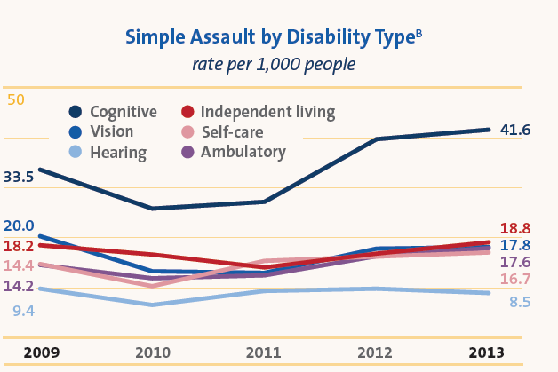
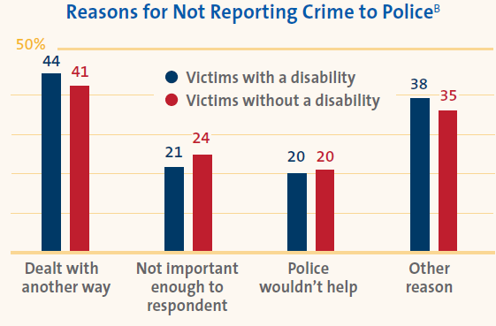
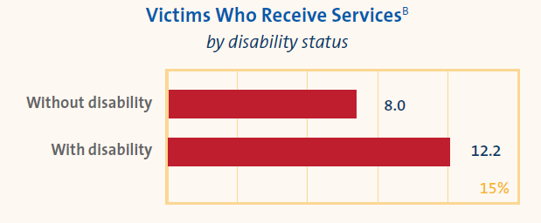
National Data

Slide 12
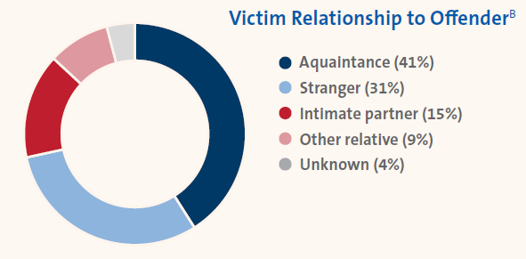
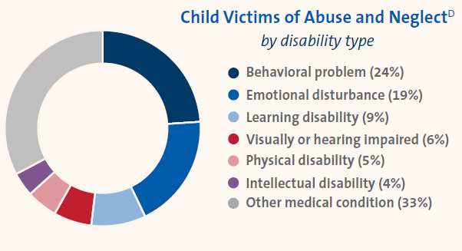
National Data
Victim Relationship to Offender
Child Victims of Abuse and Neglect

Slide 13
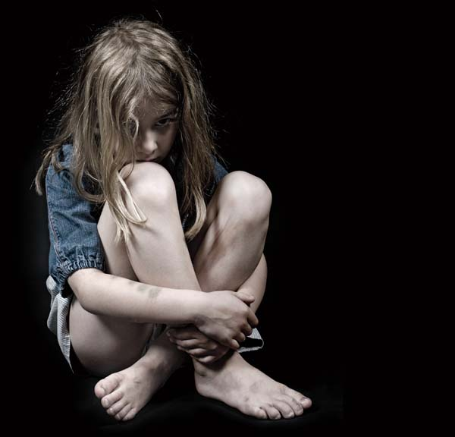
Frequency of Sexual Abuse
Notes:
The national Survey of abuse was sent out four years ago through survey Monkey. An Astounding , 7,289 responses were received from someone with a disability who either experience abuse or was directly related to someone who has a disability and has experienced abuse. 83.5% of the respondents were women and 16.6% of them were men. This is because women play such a prominent role in caregiving, teaching, social work, and protective services.

Slide 14
Frequency of Bullying
More than Once
More that 10 times
Notes:
More than 73% of people with disabilities who took the National Survey on Abuse of People with disabilities reported that the had been victims of bullying. Is was found that people with autism experienced the highest rate of bullying ( 77%).

Slide 15
Frequency of Neglect and Financial Exploitation

Slide 16
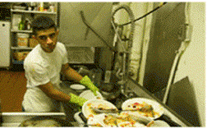
Human Exploitation or Human Trafficking
  Agriculture
  Begging
  Tourism
  Nail Salon
  Factory Labor
Labor
Some Types of Trafficking
Notes:
NEW SLIDE ADDED –NEED TO UPDATE

Slide 17
APD Clientele Data
As of
December 01, 2017, APD had 34,195 active med-waiver clients residing in various living settings.

Slide 19
Social Media and Cell Phone Safety

Slide 20
Frequency of Cyberbullying
Frequency and Characteristics of Cyberbullying
Settings where Cyberbullying Occurred
Notes:
269 people participated in a survey on Cyber Bullying. Of that 15.56% were individuals with a disability. 54.3% were men and 35.7% were women. The ages ranged from 18-40. 97.7% reported that being different was the main reason for the bullying.

Slide 21
Social Media Safety
If it’s private, do not post it. Once a comment or picture is posted, it’s in cyber space forever and can be viewed or shared by anyone.
Don’t accept friend requests from people you do not know.
Do not share your password with anyone.
Be careful about clicking on links from sources you are not familiar with.
Don’t share your financial or any personal information online.
Report any harassing or abusive content to the social media provider, a trusted family member, friend or law enforcement.
Caregivers should monitor the online activity of individuals with disabilities to ensure their safety and wellbeing.
Source: Vita Community Services (Service Support and Success Newsletter, Volume 2-Issue 4)

Slide 22
Cell Phone Safety
Never give out your or the individuals personal information over the cell phone verbally or via text.
Show the individuals how to properly use the phone, as well as the security measures that can be used to protect their privacy and information.
Monitor their usage to ensure that the individual is not participating in unhealthy device usage.
Teach Responsibility by letting the individual know that the cell phone is not a toy.
Teach emergency precautions. If the individual is in an emergency situation, they should know who to call.
Teach the individuals not to answer calls or texts from strangers.

Slide 23
DCF Investigations Involving APD Clients

Slide 24

Active Clients -vs- Investigations

Slide 25
Closed Investigations on APD Clients
January 2017-December 2017

Slide 30

Characteristics of an Abuser
Can represent any racial, religious, or socioeconomic group
Are most frequently male (for sexual abuse)
Are usually known to the victim
Can be of any age
ANYONE with a history of being an abuser is at high risk of repeating the offense either on the same individual or someone else.

Slide 31
Profiles of Caregivers who Abuse, Neglect, or Exploit
UNABLE
UNWILLING
Lack of proper training or experience,
Intellectual Disability or mental illness,
Poor health/physical condition,
Overly stressed/tired,
Impaired due to drugs/alcohol.
Repeat offenders,
May not view victims as real people with feelings and emotions,
See opportunity to take advantage of someone who may not be able to defend themselves and/or report problems.

Slide 32
Behaviors of Caregivers who may be Abusers
Refusal to follow directions or complete necessary personal tasks for dependent person,
Displaying controlling attitudes and behaviors,
Showing up late to work or not at all,
Working under the influence of alcohol or illegal drugs,
Using threats or menacing looks/ body language as a form of intimidation,
Impulsive behaviors,
Using vehicle, money or other resources without consent,
Devalues the person with developmental disabilities,
Frequently switches healthcare providers,
Speaks for the person with developmental disabilities for attention,
Displays unwelcoming or uncooperative attitude during home visits,
Frequently makes attempts to be alone with a particular individual for no apparent legitimate purpose

Slide 33
Abusive caregivers may also have…
Low self-esteem,
A mental illness, diminished intelligence, or impaired functioning
A need to control others
Frustration with authority, which can lead to displaced aggression toward weaker persons
A history of being abused or neglected as a child
A lack of attachment to the dependent person, (which can lead to thoughts by the abuser that the victim doesn’t feel or hurt in response to their abusive actions).

Slide 34
If you had to choose one thing that would be the most important indicator of abuse, what would it be?

Slide 35
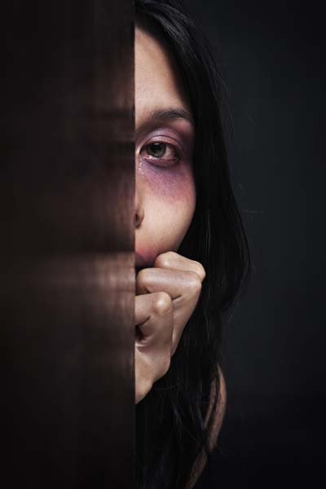
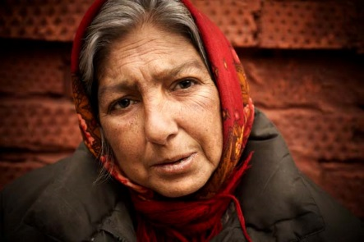


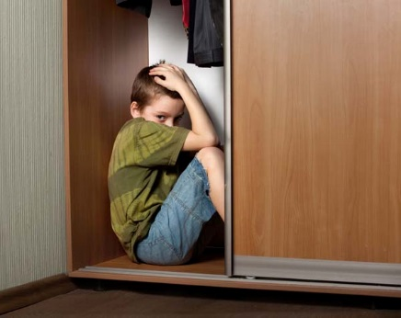

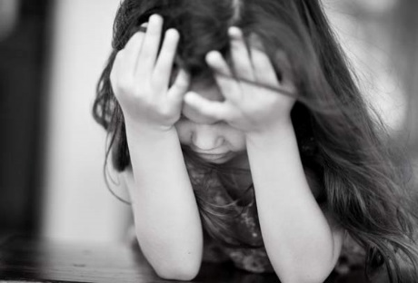

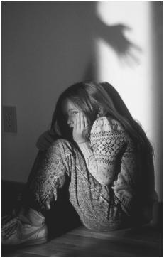
The single most important thing to look for in a person with a developmental disability to indicate the possibility of abuse, neglect, or exploitation is change.
A sudden or gradual change in appearance or behavior should always be noted and monitored.

Slide 36
Signs of Abuse
Bruises,
Burns (Cigarette, Scalds),
Scrapes, Cuts, Bite Marks, or welts
Broken Bones/Sprains/Fractures,
Dehydration,
Bleeding from ears, nose or mouth,
Poor or improper hygiene,
Malnourishment/weight loss
Aggressive shaking,
Painful urination,
Vaginal or rectal pain,
Sudden difficulty walking or sitting,
Abrasions, bleeding, or bruising in genital area,
Frequent injuries,
Unexplained injuries,
Injuries in various states of healing,
Injuries in unlikely places,
Incontinence in someone who was previously continent,
Bedsores,
Sudden decrease in bank account, balances or banking practices,
Cauliflower Ears.

Slide 37
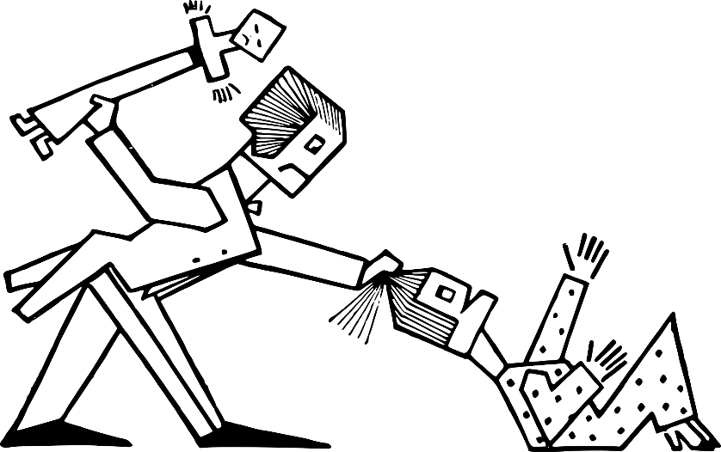
Distinguish Abuse from Accidental Injury
Things to consider…….
  Location of the injury,
  Number and frequency of injuries,
  Size and shape of injury,
  Description of how the injury occurred,
  Consistency of the injury with the person’s, developmental capability.

Slide 38
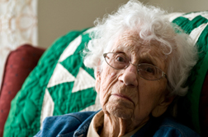
Factors That Make it Hard to Recognize Abuse, Neglect and Exploitation
Victim does not recognize abuse, neglect, or exploitation,
Communication challenges (which prevent both disclosure of the event and resulting problems),
Self-abusive behaviors,
Some symptoms may be interpreted as behavioral problems or traits of their disability.
THERE IS NO UNIVERSAL RESPONSE TO ABUSE, NEGLECT, OR EXPLOITATION. EVERY INDIVIDUAL RESPONDS DIFFERENTLY, AND IN SOME CASES THERE MAY BE NO OUTWARD SIGNS AT ALL.

Slide 39
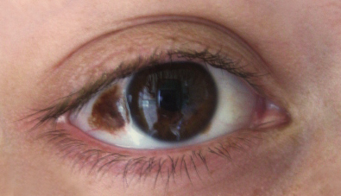
Conditions that may look like Abuse or Neglect
Injuries due to falls,
Sensory impairments,
Skin breakdown from appliances or orthopedic equipment,
Self injurious behavior (SIB),
Poor growth and failure to thrive,
Bruises from taking certain medications (such as blood thinners),
Mongolian spots,
Sensory integration problems.

Slide 40

Prevention Methods
Let’s work together to prevent abuse.

Slide 41

Notes:
Add Video <iframe width="560" height="315" src="https://www.youtube.com/embed/yhLsATwO0o4" frameborder="0" allow="autoplay; encrypted-media" allowfullscreen></iframe>

Slide 42

Client Prevention Methods
Research shows that the single most effective way to prevent abuse, neglect, and exploitation is by providing education and self-protection training directly to individuals with disabilities.

Slide 43

Training and Education
Community Awareness,
Expansion in social circles, so that more individuals would be involved in the person’s life and would therefore be able to identify and report suspected cases of abuse.
Self Protection Skills,
Appropriate and Inappropriate Behaviors by both caregivers and Service Providers,
How and when to report the problem to others,
Setting boundaries,
Modification of communication devices, so that abuse, neglect and exploitation could be easily reported,
Training and education for caregivers and Respite workers, in recognizing and reporting signs and symptoms of abuse, neglect and exploitation
Background Screening and reference checks through interviews of prospective caregivers,
Becoming familiar with the policies of service providers on such issues as restraint, seclusion, and other behavioral interventions.

Slide 44

Mandatory Reporting Requirements

Slide 45

Are you a “Mandatory” Reporter?
Who is a Mandatory Reporter?
Mandatory Reporting Requirements
Certain professions (identified in F.S 39.202 and F.S 415.107) are required to provide their name when reporting, while others may submit reports anonymously. The identity of the reporter is protected.
The Abuse/Neglect reporting laws also state that any person who has knowledge or suspicion that a child or a vulnerable adult is being abused, neglected, or exploited is now required by law to report such information.
Failure to report known or suspected cases of abuse, neglect, or exploitation is a crime.
Keep in mind that service providers can also lose their jobs and/or face legal action for failing to report.
When in doubt, report; it is always better to make a mistake on the side of caution to keep people safe from harm.
Reports should be made even if the incident happened a long time ago or in a school.
Call 1-800-ABUSE to reported suspected abuse, neglect, or exploitation
Notes:
Information that may be requested when calling the Florida Abuse Hotline is Name, age, sex, physical description, ad location of each victim alleged to have been abused, neglected or exploited. The names addresses, and telephone numbers of each alleged perpetrator. The name, address and telephone number of the person reported is optional for individuals not listed as an identified professional in the statute. The Florida abuse hotline will not turn you away of you wish to not provide your information. The description of the abuse is required. The location of the victim is needed as well. IF your call was not accepted and you feel that it should have been you can always asked to speak with a supervisor. If the person is in immediate danger, please dial 911 first before calling anyone else.

Slide 46

Barriers to reporting

Slide 47
What is standing in the way?
Victims sometimes refuse to acknowledge that there is a problem.
Persons with disabilities are often taught to be compliant and passive and are sometimes unable to distinguish between appropriate and inappropriate physical contact
Persons with disabilities may feel their report of abuse would not be believed.
Physical/cognitive impairments make it difficult for the victim to seek help.
Victims do not know where to turn for help, and they are often isolated.
Victims may believe they are financially or otherwise dependent on the abuser for their needs
Victims fear loss of a caregiver, even an abusing caregiver; they are fearful they will be forced to leave their current families or homes. Persons with disabilities may be more easily threatened by the withholding of needed care or equipment.
Notes:
People often do not recognize abuse and are quick to dismiss the visible signs of abuse by saying it was probably caused by the persons disability and because they have not seen the actual abuse, they may not believe a problem exists.

Slide 48

Your response to a victim should always communicate….
I believe you,
It’s not your fault,
You are not alone,
I want to help you.

Slide 49

Zero Tolerance Initiative
Agency for Persons with Disabilities continues to hold a strict Zero Tolerance policy in effort to address, and improve abuse, neglect, and exploitation committed against Floridians with developmental disabilities.

Slide 50
Learn more……..
Please visit our Updated Zero Tolerance Website at:
http://apd.myflorida.com/zero-tolerance/ for additional literature and educational trainings.
Christy Smiley
APD State Office
apdcares.org

Slide 51

Thank You for Attending!

